Slide 1
Object
Technical Definition:
“An Object is an Instance of a class”
“An Object is the implementation of a class”
In general we say :
“ Any tangible thing for which we want to save Information”
Now onwards we treat object technically.

Slide 2


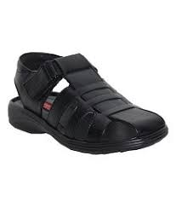



Some Examples of objects
SHOES
Female sandal
Casuals
Men sandal
Formal
Loafers
Pumpies

Slide 3




FISH

Slide 4
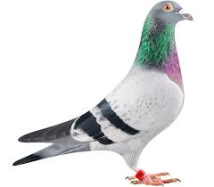



BIRD

Slide 5




Animal

Slide 6
Discussion
Object belongs to a group.
Which similar.
Have some common attributes.
Have some common behaviors.
We can categorized objects on some basic features …. ?

Slide 7
Exercise
Are there any ‘objects’ in this classroom?

Slide 8
Exercise
Are there any ‘objects’ in this classroom
Chair
Multimedia
Student
Teacher

Slide 9
Exercise
Possible Objects in this university?

Slide 10
Class
Collection of Similar object.
The objects that share some common features.
It is the a design of an object.
It is a detail of an object.
It tell us what an object contains in it.
Technical Definition:
“ A class is blueprint of an object”

Slide 11
Summarize
A class :
It’s a blue print .
It’s a design or template.
An Object:
Its an instance of a class.
Implementation of a class.
NOTE: Classes are invisible, object are visible

Slide 12

Class
Accelerator Pedal
Brake Pedal
Steering Wheel
User-friendly “interfaces” to control the car
Their mechanism is housed inside the engineering drawings or blueprints

Slide 13
Class
Suppose you want to drive a car and make it go faster by pressing down on its accelerator pedal.
What must happen before you can do this?

Slide 14
Class
before you can drive a car, someone has to design it and build it.
A car typically begins as engineering drawings
Unfortunately, you cannot drive the engineering drawings of a car—before you can
drive a car, it must be built from the engineering drawings that describe it
A completed car will have an actual accelerator pedal to make the car go faster. But even that’s not
enough—the car will not accelerate on its own, so the driver must press the accelerator
pedal to tell the car to go faster.

Slide 15
Now let’s use our car example to introduce the key object-oriented programming concepts
Performing a task in a program requires a function
The function hides from its user the complex tasks that it performs, just as the accelerator
pedal of a car hides from the driver the complex mechanisms of making the car go
Faster
In C++, we begin by creating a program unit called a class to house a function, just
as a car’s engineering drawings house the design of an accelerator pedal.

Slide 16
Class
Just as you cannot drive an engineering drawing of a car, you cannot “drive” a class.
Just as someone has to build a car from its engineering drawings before you can actually
drive the car, you must create an object of a class before you can get a program to perform the
tasks the class describes.
Note also that just as many cars can be built from the same engineering
drawing, many objects can be built from the same class

Slide 17
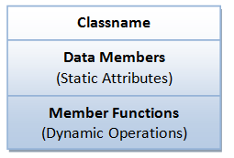
A Class is a 3-Compartment Box encapsulating Data and Functions
Classname (or identifier): identifies the class.
Data Members or Variables (or attributes, states, fields): contains the attributes of the class.
Member Functions (or methods, behaviors, operations): contains the dynamic operations of the class.

Slide 18
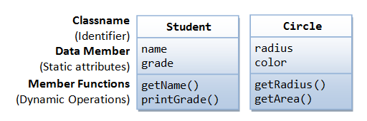
Example of classes

Slide 19
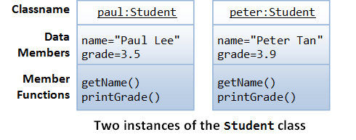
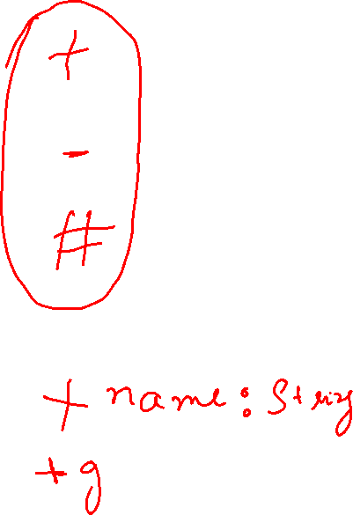
Example of objects
Each object of a class maintains its own copy of its attributes in memory

Slide 20
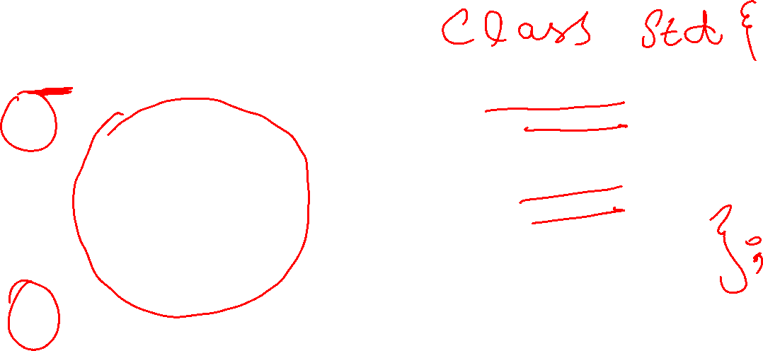
Classes
class Car
{
void accelerate() { \\ logic for acceleration }
void brake() { \\ logic for brakes }
};

Slide 21
classes
class Car
{
string model; int numOfDoors; string color;
void accelerate() { \\ logic for acceleration }
void brake() { \\ logic for brakes }
};

Slide 22
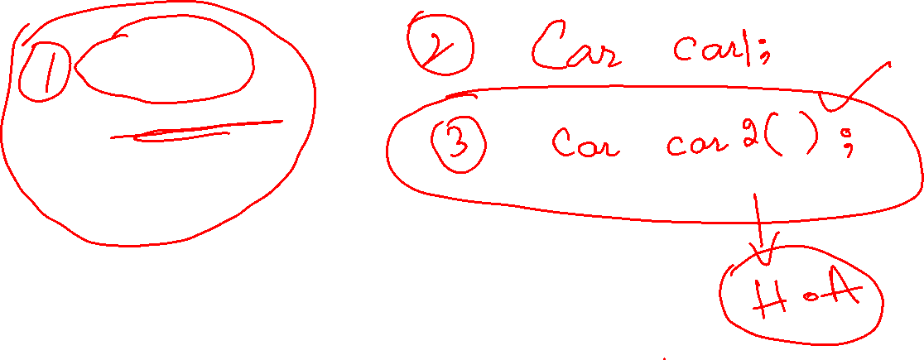
How to use the car?
int main()
{ Car car; car.accelerate();
}

Slide 23
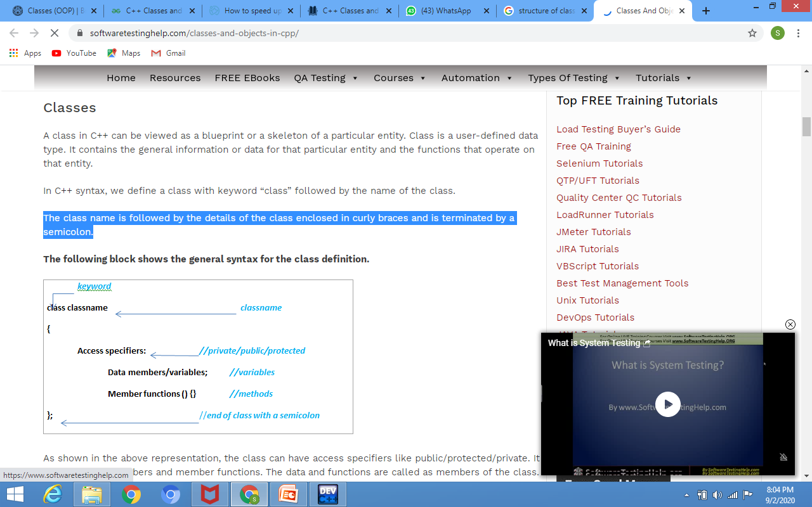
Syntax of Class
.

Slide 24
Sructure
structure is another user defined data type available in C/C++ that allows to combine data items of different kinds.
Structures are used to represent a record. Suppose you want to keep track of your books in a library. You might want to track the following attributes about each book −
Title
Author
Subject
Book ID

Slide 25
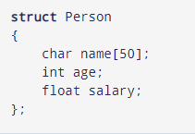
Syntax of structure
The struct keyword defines a structure type followed by an identifier (name of the structure).
Then inside the curly braces, you can declare one or more members (declare variables inside curly braces) of that structure.
For example:

Slide 26
C Structure vs C++ Structure
1. Member functions inside structure:
Structures in C cannot have member functions inside structure but Structures in C++ can have member functions along with data members.
struct person_str {
string name; int age; //constructor person_str() {
name = "default";
age = 77;}

Slide 27
C Structure vs C++ Structure
2. Direct Initialization:
We cannot directly initialize structure data members in C but we can do it in C++
#include <stdio.h>
struct Record {
int x = 7;
};
// Driver Program
int main()
{
struct Record s;
printf("%d", s.x);
return 0;
}
/* Output : Compiler Error
6:8: error: expected ':', ', ', ';', '}' or
'__attribute__' before '=' token
int x = 7;
^
In function 'main': */

Slide 28
C Structure vs C++ Structure
3. Using struct keyword:
In C, we need to use struct to declare a struct variable. In C++, struct is not necessary. For example, let there be a structure for Record. In C, we must use “struct Record” for Record variables. In C++, we need not use struct and using ‘Record‘ only would work.
#include <iostream>
using namespace std;
struct Record {
int x = 7;
};
// Driver Program
int main()
{
Record s;
cout << s.x << endl;
return 0;
}
struct Record {
int x = 7;
};
// Driver Program
int main()
{
struct Record s;
printf("%d", s.x);
return 0;
}

Slide 29
C Structure vs C++ Structure
4. Static Members: C structures cannot have static members but is allowed in C++.
5. Access Modifiers: C structures do not have access modifiers as these modifiers are not supported by the language. C++ structures can have this concept as it is inbuilt in the language.
6. Constructor creation in structure: Structures in C cannot have constructor inside structure but Structures in C++ can have Constructor creation.

Slide 30
Structure vs Classes
In C++, a structure is the same as a class except for a few differences.
The most important of them is security.
A Structure is not secure and cannot hide its implementation details from the end user while a class is secure and can hide its programming and designing details.
Following are the points that expound on this difference:
What if we forget to put an access modifier before the first field?
1) Data Members of a class are private by default and members of a struct are public by default.
struct Robot { OR class Robot {
float locX; float locX;

Slide 31
Structure vs Classes
Class
Structure
Classes are of reference types. | Structs are of value types.
All the reference types are allocated on heap memory. | All the value types are allocated on stack memory.
Class has limitless features. | Struct has limited features.
Class is generally used in large programs. | Struct are used in small programs.
A Class can inherit from another class. | A Struct is not allowed to inherit from another struct or class.

